Slide 1
TypeScript: Beyond JavaScript
Jake adams

Slide 2
What is TypeScript?
Marketing Hype
TypeScript is a language for application-scale JavaScript development.
TypeScript is a typed superset of JavaScript that compiles to plain JavaScript.
Any browser. Any host. Any OS. Open Source.
Cool, important part
Marketing Hype

Slide 3
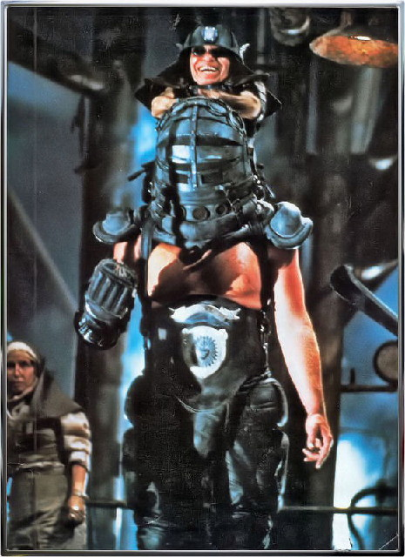
What is TypeScript?
JavaScript with a little bit extra added to it
TypeScript run Bartertown!

Slide 4
What is TypeScript?
interface IDeveloper {
firstName: string;
lastName: string;
email: string;
}
class Developer implements IDeveloper {
constructor(
public firstName: string,
public lastName:string,
public email: string) {
}
getFullName(): string {
return this.firstName + ' ' + this.lastName;
}
}
var Developer = (function () {
function Developer(firstName, lastName, email) {
this.firstName = firstName;
this.lastName = lastName;
this.email = email;
}
Developer.prototype.getFullName = function () {
return this.firstName + ' ' + this.lastName;
};
return Developer;
})();
TypeScript
Compiler

Slide 5
Lightning Demo

Slide 6

TypeScript === Happiness
Superset of JavaScript
Can use as much or as little as you want
Provides proposed EcmaScript 6 functionality today
Classes, Modules, Arrow Functions
Writes JavaScript that is probably better than what you would write yourself
Cleaner, easier to read code
Created by Anders Hejlsberg (of C#, Delphi, and Turbo Pascal fame)
Open Source
Use Jake as it’s build system

Slide 7

TypeScript !== Happiness
Still has the same limitations and pitfalls of JavaScript
Still in Beta (0.8.2 as of this presentation)
No JSHint/JSLint type tooling yet
Limited tooling outside of Visual Studio
Only Available in Visual Studio 2012
It’s it a presentation that I’m giving

Slide 8
TypeScript === undefined
TypeScript adds static typing and OO principles to JavaScript
TypeScript builds abstractions over JavaScript

Slide 9

Why Use TypeScript?
Because something a few enhancements can make a big difference….
Lance Armstrong with the aid of syntactic sugar

Slide 10

How Do I Get Started?
(aka @mkristensen forces me to change a presentation once again)

Slide 11


Visual Studio Installation
TypeScript compiler, tsc.exe, and Visual Studio compilation options
TypeScript Plugin for Visual Studio 2012
http://www.microsoft.com/en-us/download/details.aspx?id=34790
Syntaxt Highlighting, split screen editor, and compile on save
ASP.NET and Web Tools 2012.2 http://go.microsoft.com/fwlink/?LinkId=282650
Tools -> Extensions and Updates -> Web Essentials 2012

Slide 12
TypeScript Bundle Transformer

Slide 13

Node Installation
npm install –g typescript
tsc somescript.ts

Slide 14
Other Editors

Slide 15

Features

Slide 16
Keywords
class
constructor
exports
extends
implements
imports
interface
module
Public
private
… , =>, < > , ?

Slide 17
Static Typing
Demo

Slide 18
Builtin Types
string
number
bool
any
Null
undefined

Slide 19
Implicit Typing
var number1 = 1; //number
var number2: number = 2; //number
var number3: number; //number
number3 = 3;
var number4; //any
number4 = 4;
function multiply(x, y) { // (any,any) => number
return x * y;
}

Slide 20
Typing - Parameters

Slide 21
Best Common Type

Slide 22
Casting

Slide 23
Interfaces

Slide 24
Ambient Declarations
declare var $: any;

Slide 25
Type Definition Files
/// <reference path="jquery.d.ts" />
Definitely Typed Project - https://github.com/borisyankov/DefinitelyTyped

Slide 26
Classes
Constructors
Properties
Private/Public

Slide 27
Constructors

Slide 28
Properties

Slide 29
Arrow Functions

Slide 30
Modules

Slide 31
Internal Modules

Slide 32
External Modules

Slide 33

Bonus Material
Visual Studio Settings
Statics
Parameters …

